Slide 1

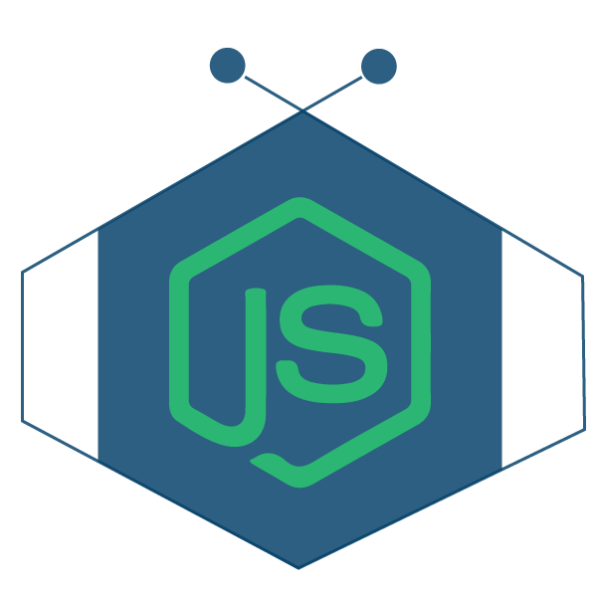

Create Restful Web Application With Node.js Express Framework
View Mastering Node.js course details at www.edureka.co/mastering-node-js
For Queries:
Post on Twitter @edurekaIN: #askEdureka
Post on Facebook /edurekaIN
For more details please contact us:
US : 1800 275 9730 (toll free)
INDIA : +91 88808 62004
Email Us : sales@edureka.co
www.edureka.co/mastering-node-js

Slide 2

Objectives
At the end of the session you will be able to learn:
Introduction of Node.js
What is the use of NPM
Express framework in nodeJS
How to create a Web services
MongoDB configuration

Slide 3
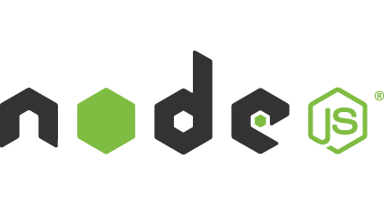
What is Node.js ?
Node.js is an open source, cross-platform runtime environment for server-side and networking applications
Node.js applications are written in JavaScript, and can be run within the Node.js runtime on OS X, Microsoft Windows, Linux, FreeBSD, NonStop and IBM. -- Wikipedia
This is based on Google’s V8 JavaScript Engine

Slide 4
What is Node.js ? (Contd.)
Guess What ?
  IT’s SINGLE THREADED !!
  No worries about : race conditions, deadlocks and other problems that go with multi-threading.
  “Almost no function in Node directly performs I/O, so the process never blocks. Because nothing blocks, less-than-expert programmers are able to develop scalable systems.” - (courtesy : nodejs.org)
Event Queue
Thread Pool
file system
Event
Loop
network
process
other

Slide 5
Basics of Node.js: npm
npm used to stand for Node Package Manager. Now it stands for nothing. Its actually not an acronym. npm is not a Node.js specific tool any more
npm is a registry of reusable modules and packages written by various developers
  Yes, you can publish your own npm packages
There are two ways to install npm packages:
  Locally: To use and depend on the package from your own module or project
  Globally: To use across the system, like a command line tool
Installing a package locally:
  The package is easily downloaded by just saying npm install <packagename>
  This will create a node_modules directory (if it does not exist yet) and will download the package there
  Once installed you can use it in any js file of your project by saying: var obj = require(‘packagename’);

Slide 6
Express Framework
Express framework provides a robust set of features for web and mobile applications.
Creating robust API is quick and easy
It provides a thin layer of fundamental web application feature.
It offers a simple way to get a server up and running.
Features of Express Framework :
  Router
  Middleware
  Template Engines
  Error Handling

Slide 7
Express Framework
By default Express supports the Jade Template Engine for the HTML Views
What is an JavaScript Template Engine: It is a framework to help bind data to your HTML views
Why do you need one?
  Helps you easily bind data from the back end with the HTML view
  Helps in bundling HTML code into reusable modules/layouts
  Adds basic conditionals & iterations / loops to your HTML. HTML does not support “If -Else” or “for” loops
Many JavaScript Template Engines are available: Jade, Handlebars, Hogan, EJS, etc.

Slide 8
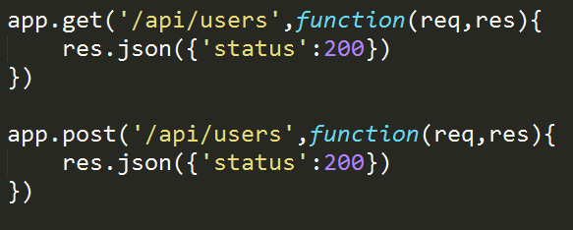
Creating RESTful API
REST API stands for Representational State Transfer
RESTful server dispatches only data for an end point and not a web page.
HTTP methods for RESTful Services:
  GET
  POST
  PUT
  DELETE

Slide 9
DEMO

Slide 10
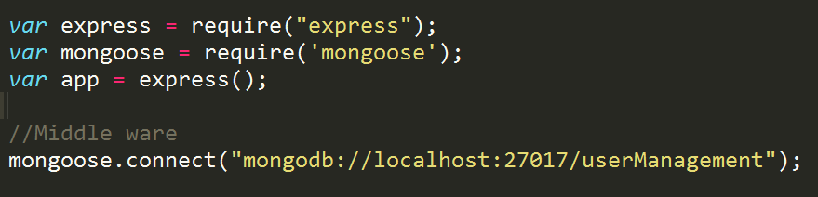
Connecting MongoDB with Node
MongoDB has rapidly grown to become a popular database for web applications and is a perfect fit for Node.JS applications
We have lot of third party modules to connect with MongoDB
  Mongoose
  MongoDB
  MongoClient
First we have to establish a connection between node app and MongoDB.
Once connection is established, fire the query to perform a CURD operation in DB

Slide 11
DEMO

Slide 12
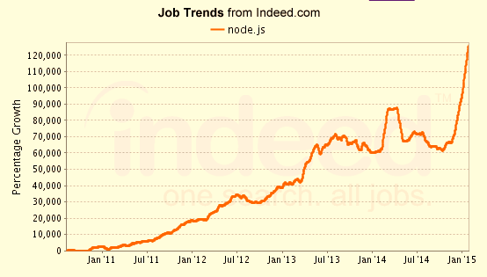
Job Trends
Salaries for Node.js Developers are already in the $60,000 range and much more.
From the graph below : The number of jobs are skyrocketing.

Slide 13
Course Topics
Module 1
  Introduction to Objects in Javascript & Node.js
Module 2
  Modules / Packages
Module 3
  Events & Streams
Module 4
  Network Communication & Web Technology in Node.js
Module 5
  Building a Web Application
Module 6
  Real-time Communication
Module 7
  Forks, Spawns and the Process Module
Module 8
  Testing in Node.js
Module 9
  Node.js in the Tech World

Slide 14
Please visit http://www.edureka.co/mastering-node-js for ongoing offer
MONSOON BONANZA : 35% OFF + Self paced PHP & MYSQL free valid till 28th June 2015

Slide 15






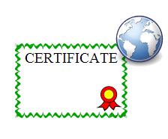
Course Features
 | LIVE Online Class
 | Class Recording in LMS
 | 24/7 Post Class Support
 | Module Wise Quiz
 | Project Work
 | Verifiable Certificate

Slide 16

Questions

Slide 17


